Slide 1


Introduction in CSS

Slide 2

Last session’s topics
HTML definition and characteristics
HTML Document Structure
HTML Elements

Slide 3
Today’s topics
HTML Forms
CSS Introduction:
Adding CSS to HTML
CSS Syntax
Cascading (priority) rules
CSS Selector Types
CSS Properties:
Styling
Coloring and adding backgrounds
Positioning

Slide 4
CSS Overview

Slide 5
CSS Definition and Characteristics
● = a language used to define the visual appearance of web pages
Allows web to separate content and structure of a website from the visual appearance
Was created in 1997, but started gaining popularity in 2000
Current standard: CSS 3
Implemented by most browsers
http://css3test.com/
https://caniuse.com/
CSS can specify different styles for different media: on-screen, print, tablets, smartphones, projectors, and even by voice or Braille-based reader

Slide 6
Cascading Style Sheet
Style Sheet
refers to the document itself; CSS files are simple text files
Contains instructions which are used to style Elements
Cascading
CSS will be applied starting from the parent and cascading (dropping) to each child, like a waterfall

Slide 7
Cascading (more)
1. Apply a style to a parent element
2. Child elements in the HTML DOM tree inherit styles from their parent
Some CSS styles are inherited and some not
Text and list-related properties are inherited: color, font-size, font-family, line-height, text-align, list-style, and others
Box-related and positioning styles are not inherited: width, height, border, margin, padding, position, float, and others
<a> elements do not inherit color and text-decoration

Slide 8
Linking CSS and HTML

Slide 9
Linking HTML and CSS
Inline:
the CSS rules in the style attribute
No selectors are needed
Embedded:
in the <head> in a <style> tag
External:
CSS rules in separate file
Usually a file with .css extension
Linked via <link rel="stylesheet" href=…> tag or
@import directive in embedded CSS block only
Chapter Three

Slide 10
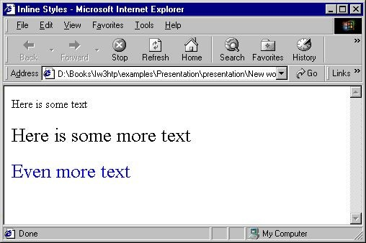
Inline Styles: Example
<!DOCTYPE html>
<html>
<head>
<title>Inline Styles</title>
</head>
<body>
<p>Here is some text</p>
<!--Separate multiple styles with a sem
<p style="font-size: 20pt">Here is some
<p style="font-size: 20pt;color: #0000F text</p>
</body>
</html>
icolon-->
more text</p> F">Even more
DO NOT USE INLINE STYLES IN YOUR CODE!
Chapter Three

Slide 11
Embedded Styles
Embedded in the HTML in the <style> tag:
<style>
...
</style>
The <style> tag is placed in the <head> section of the document
Used for document-specific styles
Chapter Three

Slide 12
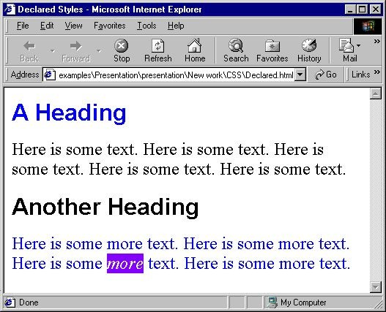
Embedded Styles: Example
embedded-stylesheets.html
<!DOCTYPE html>
<html>
<head>
<title>Embedded Style Example</title>
<style>
em {
background-color: #8000FF;
color: white;
}
h1 {
font-family: Arial, Verdana, sans-serif;
}
P {
font-size: 18pt;
}
.blue {
color: blue;
}
</style>
<head>
The rest of the code on the next page ...
Chapter Three

Slide 13
Embedded Styles: Example
embedded-stylesheets.html
... Continued from the previous page
<body>
<h1 class="blue">A Heading</h1>
<p>Here is some text. Here is some is some text. Here is some text. Here is some text.</p>
<h1>Another Heading</h1>
<p class="blue">Here is some more text Here is some more text.</p>
<p class="blue">Here is some <em>more</em> text. Here is some more text.</p>
</body>
</html>
Chapter Three

Slide 14
External CSS Styles
External linking
Separate pages can all use a shared style sheet
Only modify a single file to change the styles across your entire Web site (see http://www.csszengarden.com/)
link tag (with a rel attribute)
Specifies a relationship between current document and another
<link rel="stylesheet" type="text/css" href="styles.css“ />
document
link elements should be in the <head>
The type attribute hints the file MIME type; is not mandatory
Chapter Three

Slide 15
Default Browser Styles
Browsers have default CSS styles (user-agent styles)
Used when there is no CSS information or any other style information in the document
Caution: default styles differ from browser to browser
E.g. margins, paddings and font sizes differ most often and usually developers reset them
* { margin: 0; padding: 0; }
body, h1, p, ul, li { margin: 0; padding: 0; }
Chapter Three
15

Slide 16
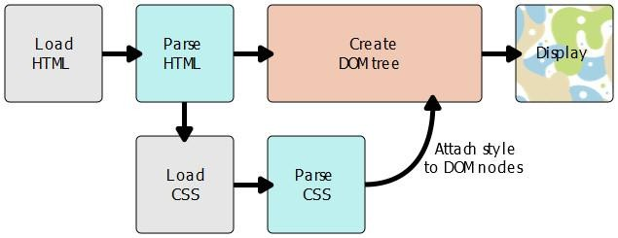
CSS and HTML

Slide 17
CSS Syntax

Slide 18
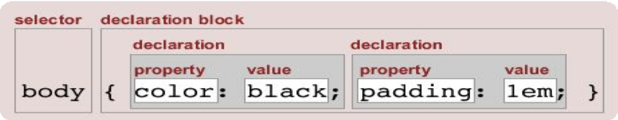
CSS Syntax in a different angle
Stylesheets consist of rules
Selectors
Declarations
Properties
Values
Selectors are separated by
commas
Declarations are separated by
semicolons
h1,h2,h3 { color: green;
font-weight: bold;
}
Properties and values are separated by
colons

Slide 19
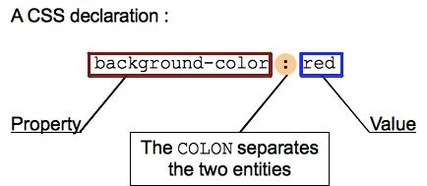
CSS Declaration
;
If a property is unknown or if a value is not valid for a given property, the declaration is deemed invalid and is wholly ignored by the browser's CSS engine
Use US spelling for properties
color, not colour

Slide 20
CSS Selectors

Slide 21
CSS Selector Types
Simple selectors
Based on element type, class or id
Combinators
Attribute selectors
Based on element’s attribute or attribute values
Pseudo-classes
Elements that exist in a certain state (hovered element, disabled checkbox)
Pseudo-elements
Match parts of content that are in a certain position in relation to an element
Multiple selectors
Apply same rules to elements selected by multiple selectors

Slide 22
Simple Selectors
HTML Tag selectors
h1 { font-family: verdana,sans-serif; }
Class selectors: .className
Multiple elements can have the same class
An element can have more than one class !
.element-class { border: 1px solid red; }
.class1.class2 { color: violet; font-size 14px; }
Id selectors: #id
An ID must be unique in the document!
#element-id { color: red; }
Chapter Three

Slide 23
Simple Selectors Workshop
Given the following HTML
...<div id=“container”>
<p class=“red”>This is some text</p>
<p>This is <span>more</span> text</p>
<p>Link to <a href=“http://www.scoalainformala.com”> Scoala Informala</a></p>
<a href=“http://www.google.com”>Google</a>
</div>...
Add a background-color: gray; style to the DIV container
Style the first paragraph and the span in red
Style the links in blue
Chapter Three

Slide 24
Combinators
Universal selector
* { font-family: verdana,sans-serif; }
Descendent selector
space - select an element nested somewhere inside another element
div p { border: 1px solid red; }
Direct Child selector
> - select an element that is the immediate children of another element
div > p { color: red; }
Chapter Three

Slide 25
Combinators (contd.)
Immediate sibling selector
○ + - select an element that is an immediate sibling of another element (i.e. right next to it, at the same level in the hierarchy)
div + p { color: blue; }
Chapter Three

Slide 26
Combinators Workshop
Given the following HTML
<div id=“container”>
<p class=“red”>This is some text</p>
<p>This is <span>more</span> text</p>
<p>Link to <a href=“http://www.scoalainformala.com”> Scoala Informala</a></p>
<a href=“http://www.google.com”>Google</a>
</div>
<p>This is <span>some other</span> text</p>...
Style the link to Scoala Informala in blue , and the link to Google in green
Style the “some other” span in pink
Chapter Three

Slide 27
Attribute Selectors
[attr] attribute attr, whatever its value
input[disabled] { color: blue; }
[attr=val] attribute attr, and with value = val
[id=“container”] { border: 1px solid red; }
[attr|=val] attribute attr for which the value is exactly val or starts with val-
[attr^=val] attribute attr for which the value starts with val
[attr$=val] attribute attr for which the value ends with val
[attr*=val] attribute attr for which the value contains the string val
Chapter Three

Slide 28
Pseudo Selectors
Pseudo-selectors don't select actual elements, but rather certain parts of elements, or elements only in certain contexts
Pseudo-classes
added on to the end of selectors to specify that you want to style the selected elements only when they are in certain state
selector:keyword { color: blue; }
Pseudo-elements
added to the end of selectors to select a certain part of an element
selector::keyword { border: 1px solid red; }
Chapter Three

Slide 29
State-Related Pseudo-Classes
:enabled - any enabled element: if it can be activated (e.g. selected, clicked on or accept text input) or accept focus
:disabled - the opposite of enabled
:checked - any radio button, checkbox or select option that is checked or toggled to an on state
:link - links that have not yet been visited
:visited - links that have been visited
:hover - when the user designates an element with a pointing device, but does not necessarily activate it
:active - an element (such as a button) that is being activated by the user
For anchor links, use the LVHA (LoVe-HAte) order for pseudo-classes, otherwise they might be overwritten! [link , visited, hover, active]

Slide 30
Structural Pseudo-Classes
:first-child - first element among a group of sibling elements
:last-child - last element among a group of sibling elements
:only-child - an element that has no siblings
How can we write this using :first-child and :last-child?
:nth-child(an+b) - element whose numeric position in a series of siblings matches the pattern an+b
How to select every second child?
:first-of-type - first element of its type among a group of sibling elements
:nth-of-type(an+b) - element that has an+b-1 siblings of the same type before it, where n is positive or zero
:nth-last-of-type(an+b) - same as nth-of-type, but it counts items backwards from the end, not the beginning

Slide 31
More Pseudo-Classes
:not(X) - matches elements that are not represented by the argument. X must not contain another negation selector
This selector only applies to one element; you cannot use it to exclude all ancestors.
For instance, body :not(table) a will still apply to links inside of a table, since <tr> will match with the :not() part of the selector.
:target - a unique element (the target element) with an id matching the URL's fragment
https://developer.mozilla.org/en-US/docs/Web/CSS/:target

Slide 32
Pseudo-Elements
::after - creates a pseudo-element that is the last child of the selected element
::before - creates a pseudo-element that is the last child of the selected element
::first-letter - first letter of the first line of a
block-level element, but only when not preceded by other content (such as images or inline tables)
::first-line - first line of a block-level element
::selection - the portion of a document that
has been highlighted by the user (such as with the mouse)
can’t apply background-image
HTML:
<q>Some quotes</q>, he said, <q>are better than none</q>.
CSS:
q::before { content: "«"; color: blue;
}
q::after { content: "»"; color: red;
}

Slide 33
Multiple Selectors With Pseudo-Classes
You can also select multiple types of elements and apply a single rule set to all of them
Include multiple selectors separated by commas
Pseudo-classes can be added in the selection
Combine selectors as your project needs it
div#container, span:only-child, h1 { color: blue; }
a, em:hover, p:last-child { letter-spacing: 5px; color: red;}

Slide 34
Cascading Rules

Slide 35
Cascading (priority) Rules
Three factors that determine which CSS style wins:
Specificity
Importance
Order of CSS Rule

Slide 36
Specificity
● A “score” which determins the priority of a CSS selector
Think of Specificity as 4 groups of numbers
Its starting form is 0 – 0 – 0 – 0
For each inline style: add 1-0-0-0
For ID: add 1-0-0
For each class, attribute, or pseudo-class: add 1-0
Tag: add 1
Each group can be larger than 10
Examples of specificity, in winning order:
1 – 0 – 0 – 1 (inline style, 1 tag) – added inline style on a simple element
0 – 1 – 2 – 1 (1 id, 2 classes, 1 tag) - #id .class1.class2 ….. div
0 – 0 – 5 – 10 (5 classes, 10 tags) - .class1 .class2 …. div div div span a div ….

Slide 37
Order of CSS Rules
later rules will win over earlier rules
Is a factor when multiple competing selectors have the same importance and specificity
div { color: blue }
div { color: red; width: auto; border: 10px solid red;}
div { color: purple; width: 200px; border: 1px solid #000;}
span.item-text { color: purple; background: none; }
span.item-text { color: cyan; background: green; }

Slide 38
Importance
An !important rule will always win
div { color: blue !important; }
div#container { color: red; }
The only way to override this !important declaration would be to include another !important declaration of the same specificity, later in the source order
Do NOT use !important unless absolutely necessary !

Slide 39
Readings & Tutorials
http://www.learn-html.org/en/Styles
http://benhowdle.im/cssselectors/
https://www.smashingmagazine.com/2016/05/an-ultimate-guide-to-css-pseudo-classes-and-pseudo-ele ments/
https://specificity.keegan.st/
https://www.codecademy.com/en/courses/learn-html-css/

